Slide 1

WIREFRAME:
Supporting Data-dependent Parallelism through Dependency Graph Execution in GPUs
AmirAli Abdolrashidi†, Devashree Tripathy†, Mehmet Esat Belviranli‡,
Laxmi Narayan Bhuyan†, Daniel Wong†
†University of California Riverside
‡Oak Ridge National Research Lab

Slide 2
Outline
Introduction
Wireframe
DATS: Dependency-Aware TB Scheduler
Evaluation
Conclusion

Slide 3
Introduction
Since 2007, CUDA allows general-purpose programming for GPUs.

Slide 4
Introduction
Despite the support for parallelism, GPUs lack support for data-dependent parallelism.
No prior work has provided a generalized solution to inter-block data dependencies.

Slide 5
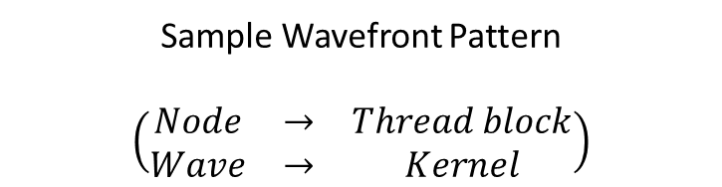
CUDA Code Example
Global Barriers (Original)
int main() {
for (int i=0; i<nWaves; i++) {
kernel<<<GridSize, BlockSize>>>(args);
cudaDeviceSynchronize();
}
}
__global__ void kernel(args) {
processWave();
}
Enormous host-side kernel launch overhead!
Sample Wavefront Pattern
$$\left(\begin{matrix}Node & → & Thread block \\ Wave & → & Kernel\end{matrix}\right)$$
Additional delay per TB execution
Notes:
e.g. Node 10 could execute considering nodes 9 and 6 are done. But it has to wait for 12 and 3 as well!

Slide 6
CUDA Code Example
CUDA Dynamic Parallelism (CDP)
int main() {
kernel<<<GridSize, BlockSize>>>(0, args);
cudaDeviceSynchronize();
}
__global__ void kernel(i, args) {
if(i == nWaves) return;
processWave();
if(threadIdx == 0) {
kernel<<<GridSize,BlockSize>>>(i+1,args);
cudaDeviceSynchronize();
}
syncthreads();
}
Kernel Execution Pattern

Slide 7
CUDA Code Example
CUDA Dynamic Parallelism (CDP)
int main() {
kernel<<<GridSize, BlockSize>>>(0, args);
cudaDeviceSynchronize();
}
__global__ void kernel(i, args) {
if(i == nWaves) return;
processWave();
if(threadIdx == 0) {
kernel<<<GridSize,BlockSize>>>(i+1,args);
cudaDeviceSynchronize();
}
syncthreads();
}
No more host-side kernel launch
  Device-side launches faster
Support for inter-block parallelism
Spawning depth limit
  24 levels

Slide 8
CUDA Code Example
CDP (Nested)
int main() {
parentKernel<<<GridSize, BlockSize>>>(0, args);
cudaDeviceSynchronize();
}
__global__ void parentKernel(i, args) {
for (int i=0; i<nWaves; i++) {
if(threadIdx == 0) {
childKernel<<<GridSize, BlockSize>>>(args);
cudaDeviceSynchronize();
}
syncthreads();
}
}
__global__ void childKernel(args) {
processWave();
}
Kernel Execution Pattern

Slide 9
CUDA Code Example
CDP (Nested)
int main() {
parentKernel<<<GridSize, BlockSize>>>(0, args);
cudaDeviceSynchronize();
}
__global__ void parentKernel(i, args) {
for (int i=0; i<nWaves; i++) {
if(threadIdx == 0) {
childKernel<<<GridSize, BlockSize>>>(args);
cudaDeviceSynchronize();
}
syncthreads();
}
}
__global__ void childKernel(args) {
processWave();
}
Spawning depth is no more a constraint
The device-side kernel launch still has significant overhead

Slide 10
Motivation
There is a need for a generalized support for finer-grain inter-block data dependency for more performance and efficiency.

Slide 11
Motivation
Current limitations
  High device-side kernel launch overhead
  No general inter-block data dependency support
Our solution: Wireframe
  Hybrid HW/SW solution
    Hardware support for dependent parallelism
    Thread block scheduling
    Programming model
  Main focus is inter-block dependencies

Slide 12
Wireframe Overview
Host (CPU)
Device (GPU)
Notes:
Notes:
Renaming:
Used as reference in the thread block scheduler
Helps minimize used memory size by minimizing the level range between dependent nodes. -> Maximizing the number of nodes cached in hardware
No? -> Large CSR Range -> Inefficient caching!
Key challenges:
Efficient caching -> Solved by HW technique DGB
Efficient scheduling -> LVL bound scheduling

Slide 13
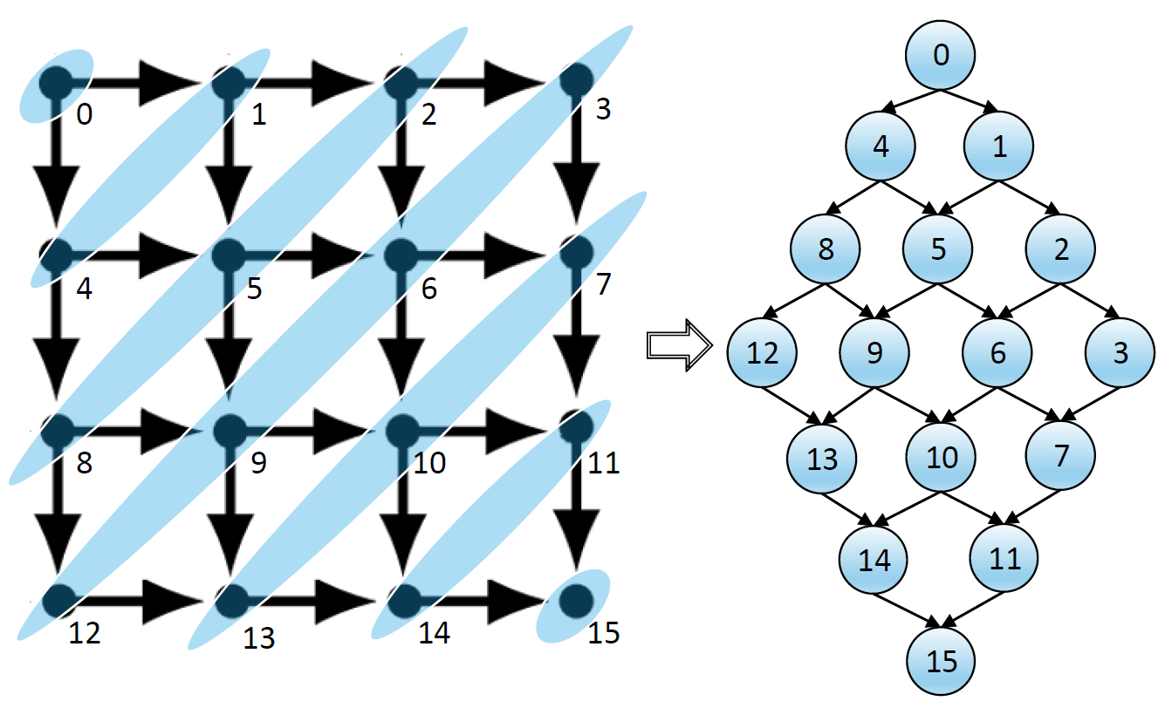
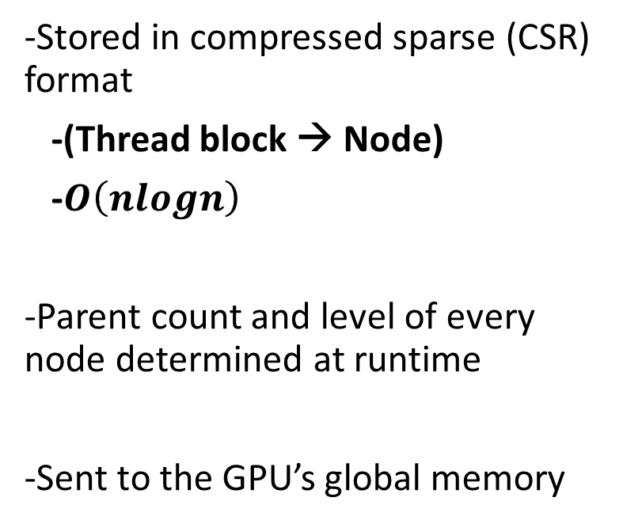
Dependency Graph
-Stored in compressed sparse (CSR) format
-(Thread block → Node)
-$O\left(nlogn\right)$
-Parent count and level of every node determined at runtime
-Sent to the GPU’s global memory

Slide 14
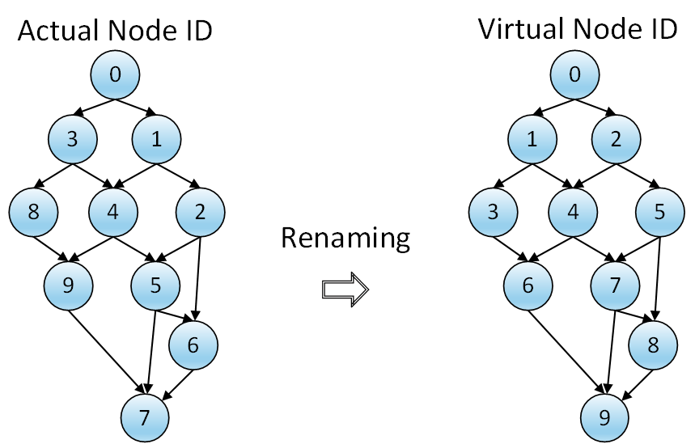
Node Renaming
During CSR conversion
To minimize data level range in cache

Slide 15
Programming Model
New functions are needed to support dependency in CUDA
  Add parent
  SM assignment policy selection
Proposing DepLinks model
  Would assign a dependency graph generation function to a kernel
  Easy to learn and use
    Less burden on the programmer

Slide 16
Code Comparison
DepLinks (Wireframe)
parent1
#define parent1 dim3 (blockIdx.x-1, blockIdx.y, blockIdx.z);
#define parent2 dim3 (blockIdx.x, blockIdx.y-1, blockIdx.z);
void* DepLink() {
if (blockIdx.x > 0) WF::AddDependency(parent1);
if (blockIdx.y > 0) WF::AddDependency(parent2);
}
int main() {
kernel<<<GridSize, BlockSize, DepLink>>>(0, args);
cudaDeviceSynchronize();
}
__WF__ void kernel(args) {
processWave();
}
parent2
One kernel launch!
Notes:
DepLinks can be used to create barrier primitives.

Slide 17
Outline
Introduction
Wireframe
DATS: Dependency-Aware TB Scheduler
Evaluation
Conclusion

Slide 18
Dependency-Aware TB Scheduler (DATS)
Thread block scheduler
  Issues the relevant thread block at the time for execution based on the dependency graph
Dependency Graph Buffer (DGB)
  Cache data from global memory
  Challenge: Efficient caching and data utilization

Slide 19
DATS Overview
Edge Start
Global
Parent
Level
NodeID
Counter
32 bits
16 bits
16 bits
16 bits
Base
Pointer
Global Edge Start
GLOBAL MEMORY
Global Edge Start
0
6
7
9
11
12
14
Global Node Array
(Too slow)
Node index
2
4
7
9
11
12
0
1
2
3
4
5
6
7
8
Global Node ID
Global ID
1
2
3
4
4
5
6
6
7
7
8
9
8
9
9
Global
Edge Array
Edge index
0
1
2
3
4
5
6
7
8
9
10
11
12
13
14
Translation of Global Edge Start to Local Edge Start
$$LES_{i}=\left(GES_{i}\right)\%\left|EdgeArray\right|$$
Local Edge Start
DEPENDENCY GRAPH BUFFER (DGB)
Local Edge Start
0
2
3
4
Local Node Array
Pending Update Buffer
(Circular buffer)
Node index
0
1
2
3
H
Global Node ID
Global ID
6
7
7
8
8
5
6
Local Edge Array
Node Insertion Buffer
Edge index
0
1
2
3
4
5
6

Slide 20
Dependency Graph Buffer
States:
State | R | W | W | W
Parent Count | 0 | 1 | 1 | 1
Level | 0 | 1 | 1 | 2
Global Node ID | 0 | 1 | 2 | 3
Wait
Ready
Processing
Done
T
H
Tail
Head
Local Node Array
0 | 2 | 4 | 6
Local Edge Start
Local Edge Array
1 | 2 | 3 | 4 | 4 | 5 | 6
Global Node ID

Slide 21
Example: Child Node Execution
States:
State | R | W | W | W
Parent Count | 0 | 1 | 1 | 1
Level | 0 | 1 | 1 | 2
Global Node ID | 0 | 1 | 2 | 3
1
D
3
R
3
R
Wait
2
0
2
0
Ready
Processing
Done
T
4
H
1
0
2
4
6
1 | 2 | 3 | 4 | 4 | 5 | 6

Slide 22
Example: Update Buffer Store
States:
State | D | P | P | W
Parent Count | 0 | 0 | 0 | 1
Level | 0 | 1 | 1 | 2
Global Node ID | 0 | 1 | 2 | 3
1
D
Wait
Ready
Processing
Done
T
H
1
2
2
Pending Update Buffer
0
2
4
6
#4
#5
1 | 2 | 3 | 4 | 4 | 5 | 6

Slide 23
Example: Invalidation…
States:
State | D | P | D | W
Parent Count | 0 | 0 | 0 | 1
Level | 0 | 1 | 1 | 2
Global Node ID | 0 | 1 | 2 | 3
D
3
R
Wait
2
0
Ready
Processing
Done
5
T
H
Enough spaces to load to DGB
1
4
0
2
4
6
#4
#5
#4
1 | 2 | 3 | 4 | 4 | 5 | 6

Slide 24
Example: …Reloading data
States:
State | W | W | D | R
Parent Count | 2 | 1 | 0 | 0
Level | 2 | 2 | 1 | 2
Global Node ID | 4 | 5 | 2 | 3
Wait
Ready
Processing
Done
6
T
H
Load complete!
0
2
-
6
#4
#5
#4
6 | 7 | 7 | - | - | - | 6

Slide 25
Example: Update Buffer Load
States:
State | W | W | D | P
Parent Count | 2 | 1 | 0 | 0
Level | 2 | 2 | 1 | 2
Global Node ID | 4 | 5 | 2 | 3
R
3
R
Wait
1
2
0
0
Ready
Processing
Done
H
T
1
4
0
2
-
6
#4
#5
#4
6 | 7 | 7 | - | - | - | 6

Slide 26
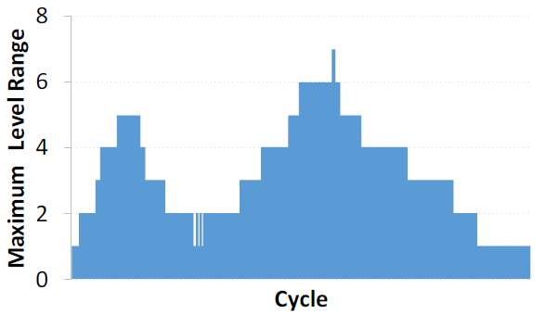
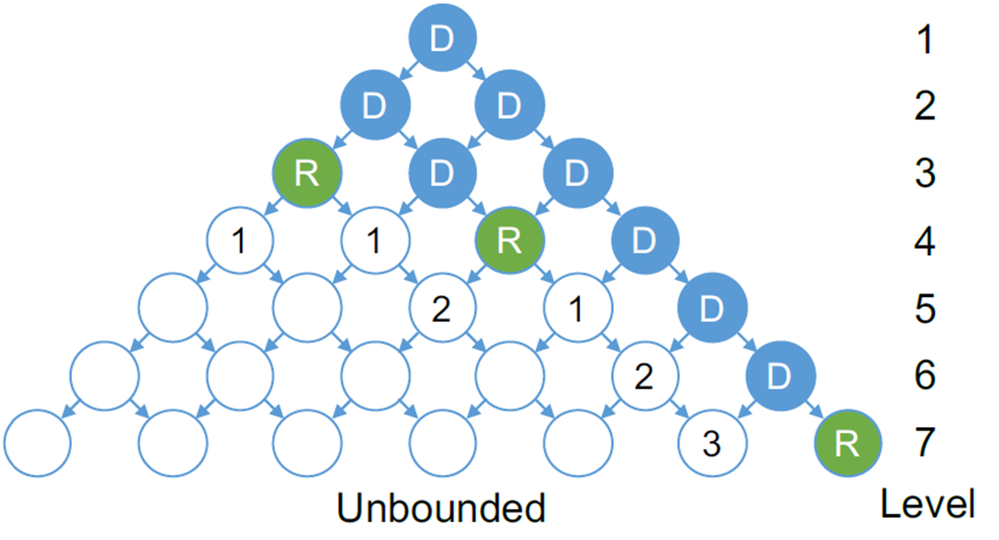
Level Range
Imbalanced execution may entail using the baseline TB scheduling policy (LRR).
More level range means:
-Larger DGB is required
-Might limit CTA execution
Key challenge:
Efficient scheduling

Slide 27
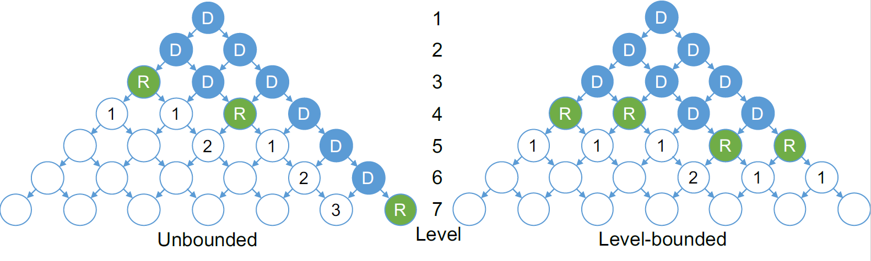
Level-bound Scheduling (LVL)
Prioritizing lower-level thread blocks in the graph
More ready nodes → More parallelism
Minimizing the caching operation
Limiting the level range to avoid serialization

Slide 28
Outline
Introduction
Wireframe
DATS: Dependency-Aware TB Scheduler
Evaluation
Conclusion

Slide 29
Evaluation
Evaluation platform
  GPGPU-Sim v3.2.2 (GTX480)
  Six modified benchmarks to actively make use of data dependency
    HEAT2D, IMG_INT, DTW
    HIST, SOR, SW
Cases
  Global, CDP
  DepLinks primitives
  LRR and LVL
    LVL=3
Notes:
DepLinks: Replaced global barriers with our dependency graph primitives (LVL=0)

Slide 30
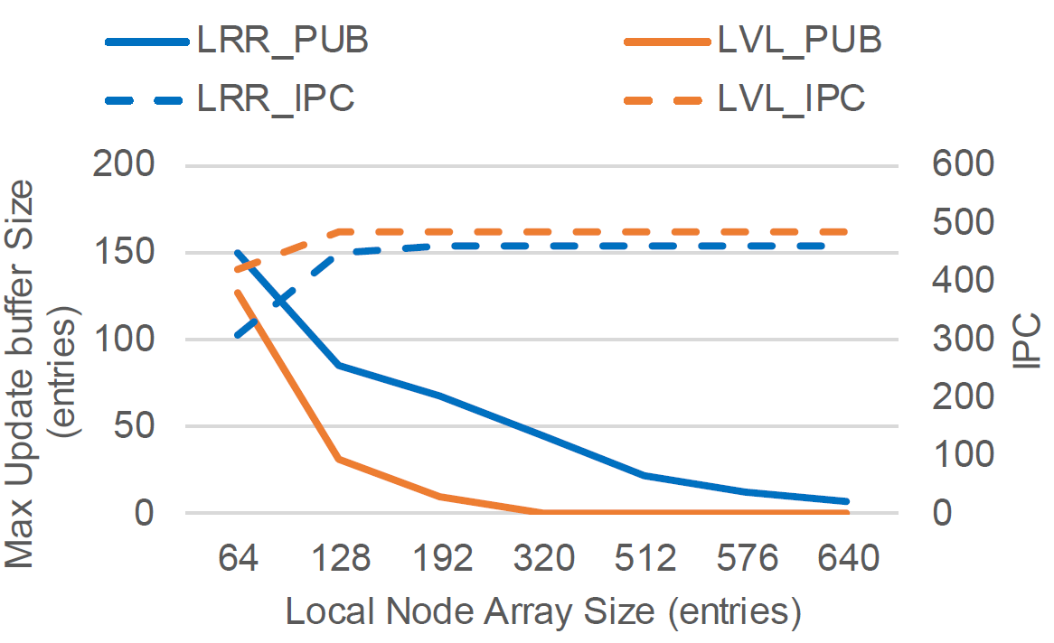
Local Node Array Size
Empirical estimation used
Minimum size chosen (128 entries)
Notes:
Empirical estimation

Slide 31
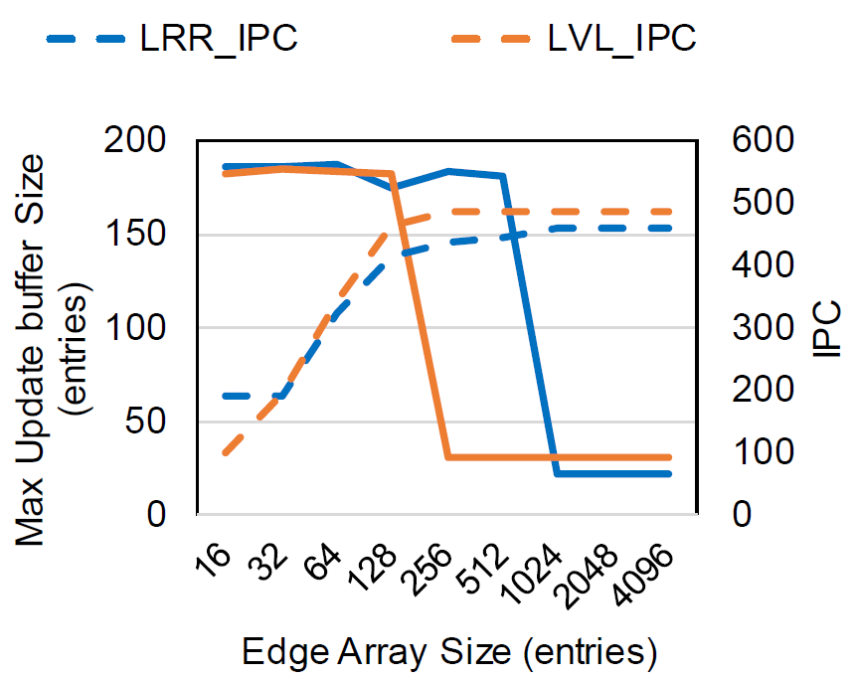
Local Edge Array Size

Slide 32
Evaluation
2KB area overhead
No significant impact on L2 miss rate
Low memory request overhead
  0.13% Average
Performance improvement
  45% average improvement

Slide 33
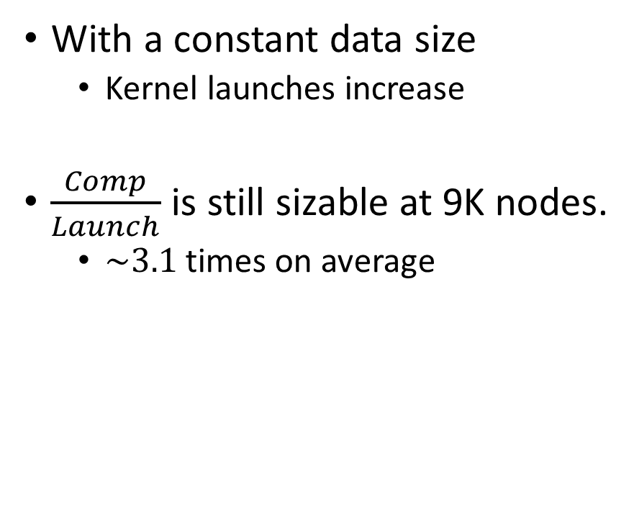
Computations vs Launch Overhead
With a constant data size
  Kernel launches increase
$\frac{Comp}{Launch}$ is still sizable at 9K nodes.
  $\sim 3.1$ times on average

Slide 34
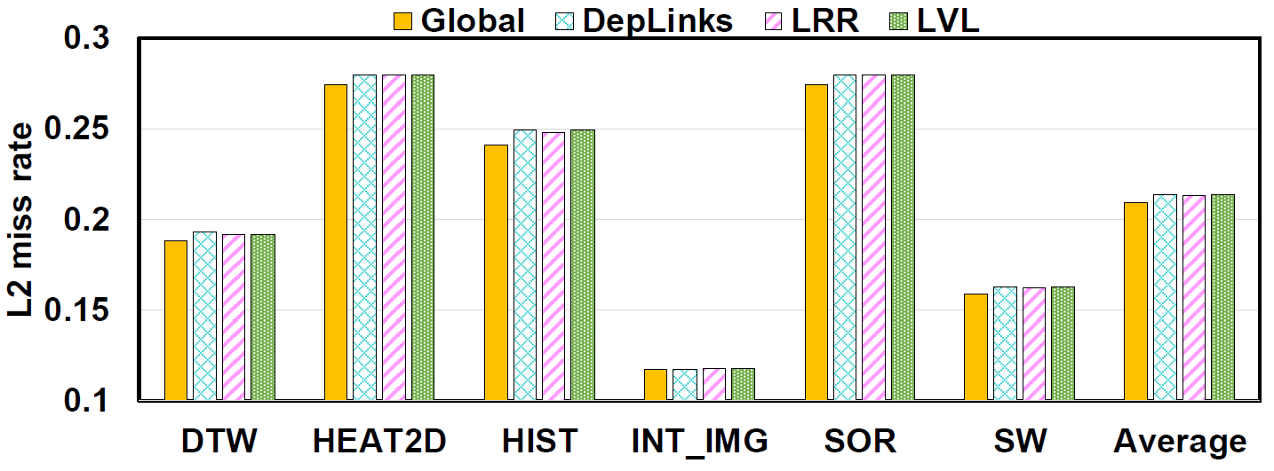
Performance
Impact on L2 ~ 0.5%

Slide 35
Performance Breakdown
(Graph size = 4K)

Slide 36
Performance
Speedup across different graph sizes
+65%
+45%

Slide 37
Conclusion
Supporting generalized inter-block dependencies through hardware
Minimizing caching through level-bound TB scheduling
45% average improvement over the baseline

Slide 38
Conclusion
Future Work
  More policies regarding the locality/load balance for SMs
  Dynamic dependency
    Ability to run workloads with variable sizes, e.g. BFS
  Automation/optimization of the graph generation by the compiler
    No more load on the programmer!

Slide 39
Thank you!
Questions?

Slide 40
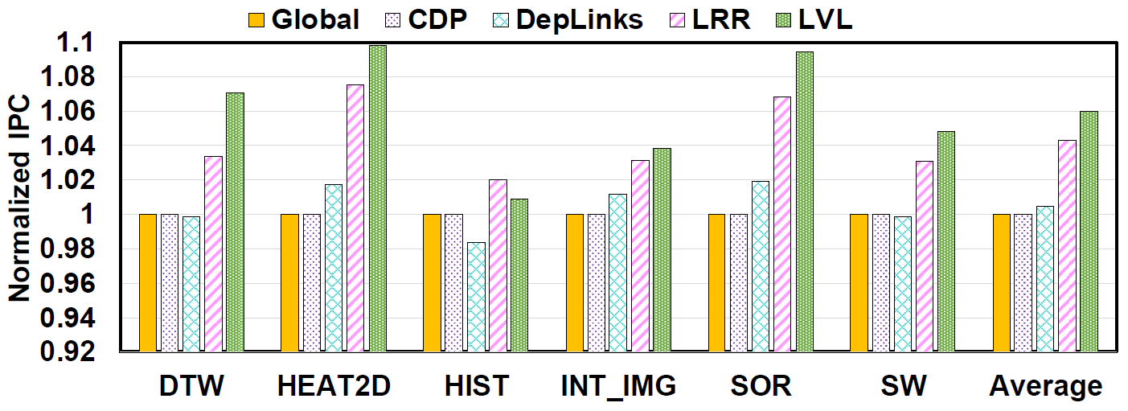
Performance (IPC)

Slide 41
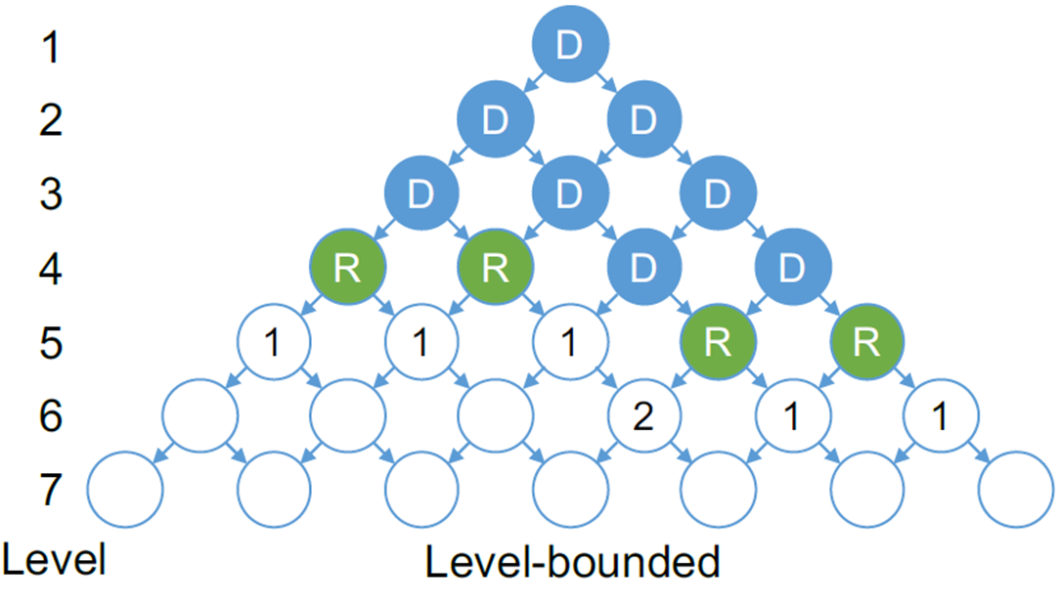
LVL vs LRR

Slide 42
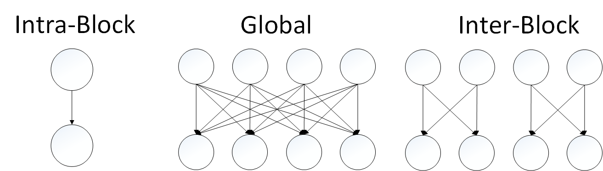
DepLinks Synchronization Primitives

Slide 43
Thank you!
Questions?

